Slide 1
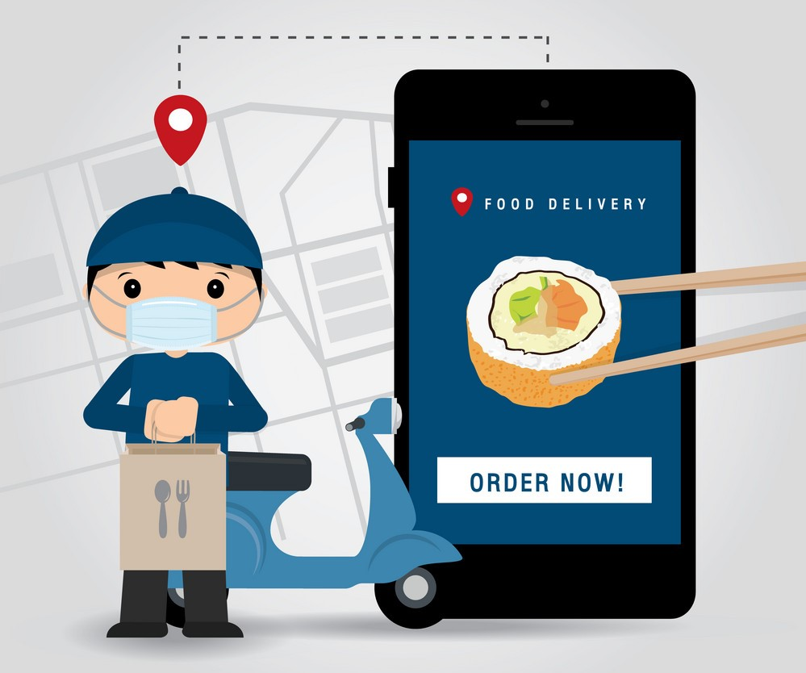
Online food ordering system
Group 4 : Vaishnav Cr, Mohamed fawaz hussain

Slide 2
Table of contents
INTRODUCTION
AIM
ALGORITHM
WORKING DIAGRAM
OUTPUT
ADVANTAGES AND DISADVANTAGES

Slide 3
iNTRODUCTION
The online food ordering system is one of the latest servicers most fast food restaurants are adopting.
The online food ordering system is a program to order food via online as per the need of a consumer.
The system helps both consumer and restaurateur to manage the food orders easily and quickly at their fingertips.

Slide 4
This system helps to get rid of time consuming calls over phone for ordering food and to reduce the hurry burry in a restaurant.
It also enhances the speed and standardization of taking food orders from customers.
Due to current situation (covid-19) the need of such services are increasing day by day.

Slide 5
GROWTH of online food ordering apps

Slide 6
Aim
The following are the functions included in this project :
First of all the system helps to find the restaurants in your locality.
After selecting a particular restaurant the customer can see the categories and menu provided by the restaurant.
We can add items to a cart from each category with their corresponding code

Slide 7
After adding items to the cart we can cancel each one of them if we change our mind.
At last the customer can see the items he/she ordered and get to know the total cost, And whether the order is placed or not.
User can confirm the order and can input the delivery address which the order has to be delivered
Customers are presented with a conventional menu
Customer decide and place the orders
Meanwhile the order list sent right back to the restaurant

Slide 8
Algorithm
Start
Input the location from user
Choose the restaurant from that particular location
Display the categories of food from that restaurant
4.1 Choose the category as per user’s wish

Slide 9
Read the items from each category with their corresponding code, meanwhile these items were added to the cart
If you finish adding items to the cart from each category enter ‘0’
6.1. Display the category of that restaurant again
6.2. You can continue your order

Slide 10
Repeat step 4 to 6 until condition became false
Display whether the order is finished or not and take the input
Read the value of remove
If the input is ‘y’
10.1. Display the Items we added and total cost

Slide 11
At this point, if user change their mind,
they can remove any items from the cart
If your order is finished you have to confirm the order
12.1. If Input is ‘1’ (order confirm)
12.1.1. Input Pin code, Name, House Name, Phone
number to get to know the delivery address

Slide 12
12.1.2. Display the delivery address & further details
12.1.3. Display the Total bill
Stop

Slide 13
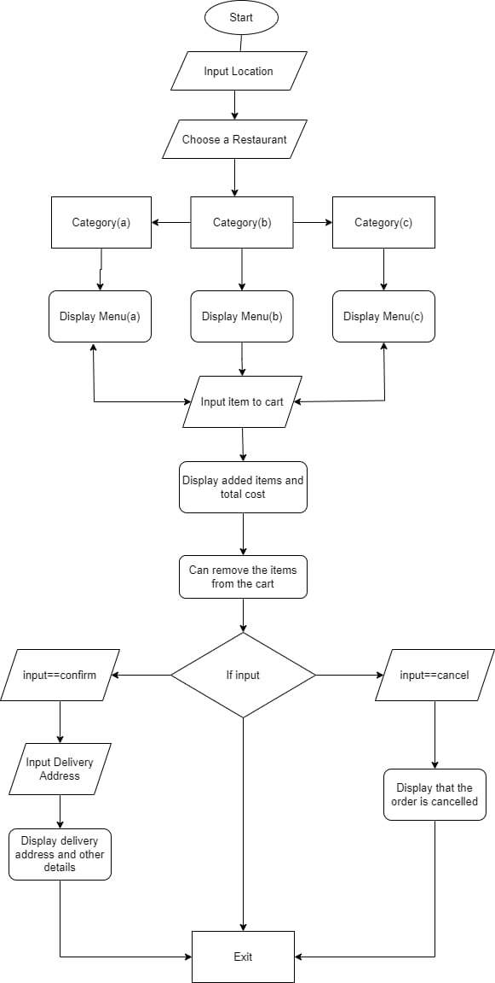
Working diagram

Slide 14
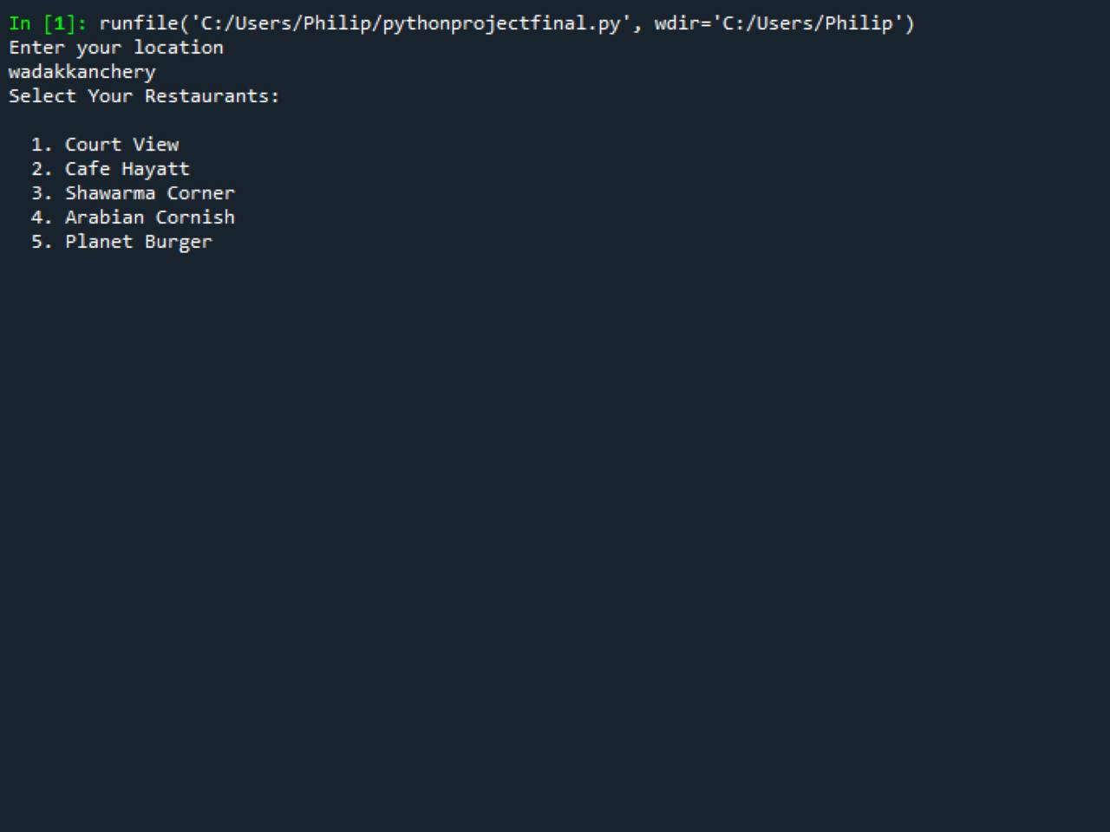
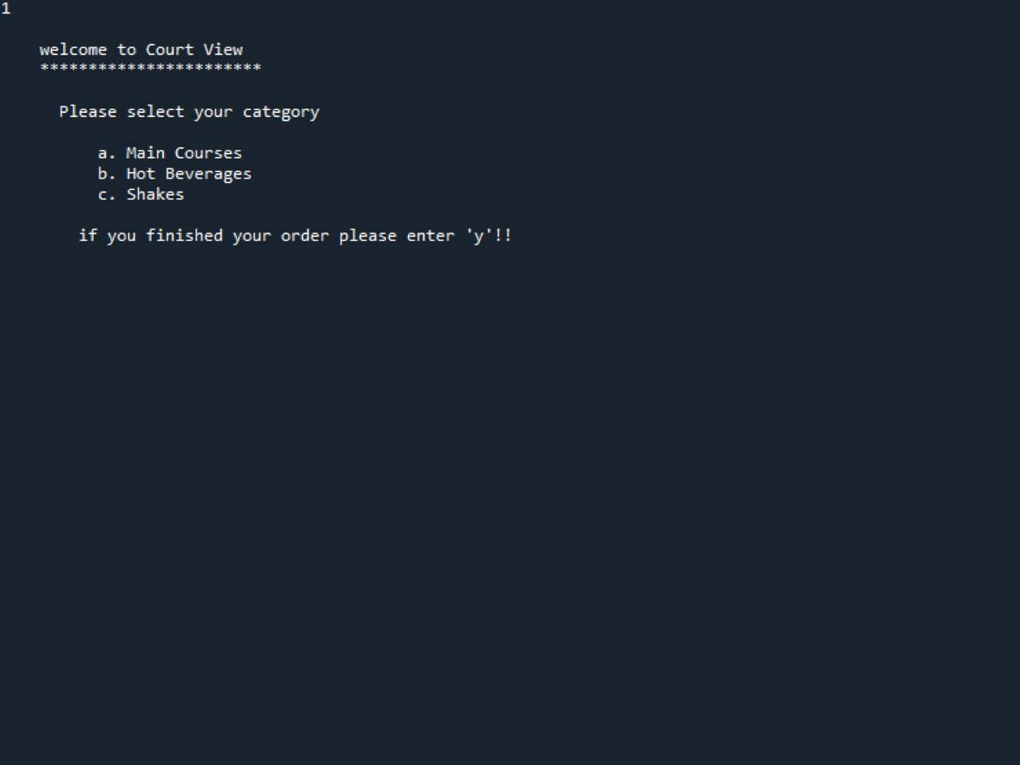
Output

Slide 15
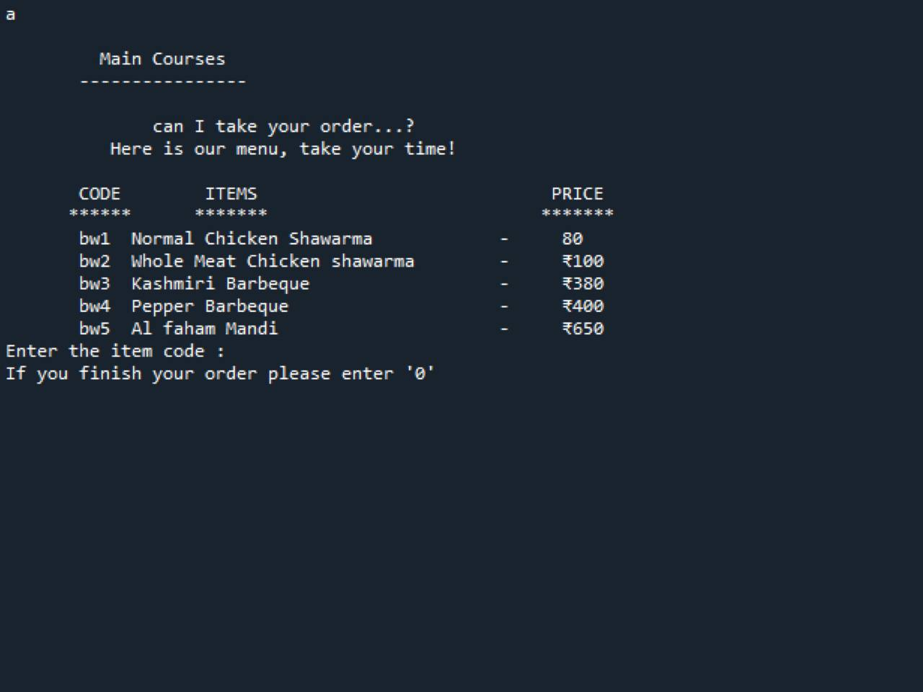
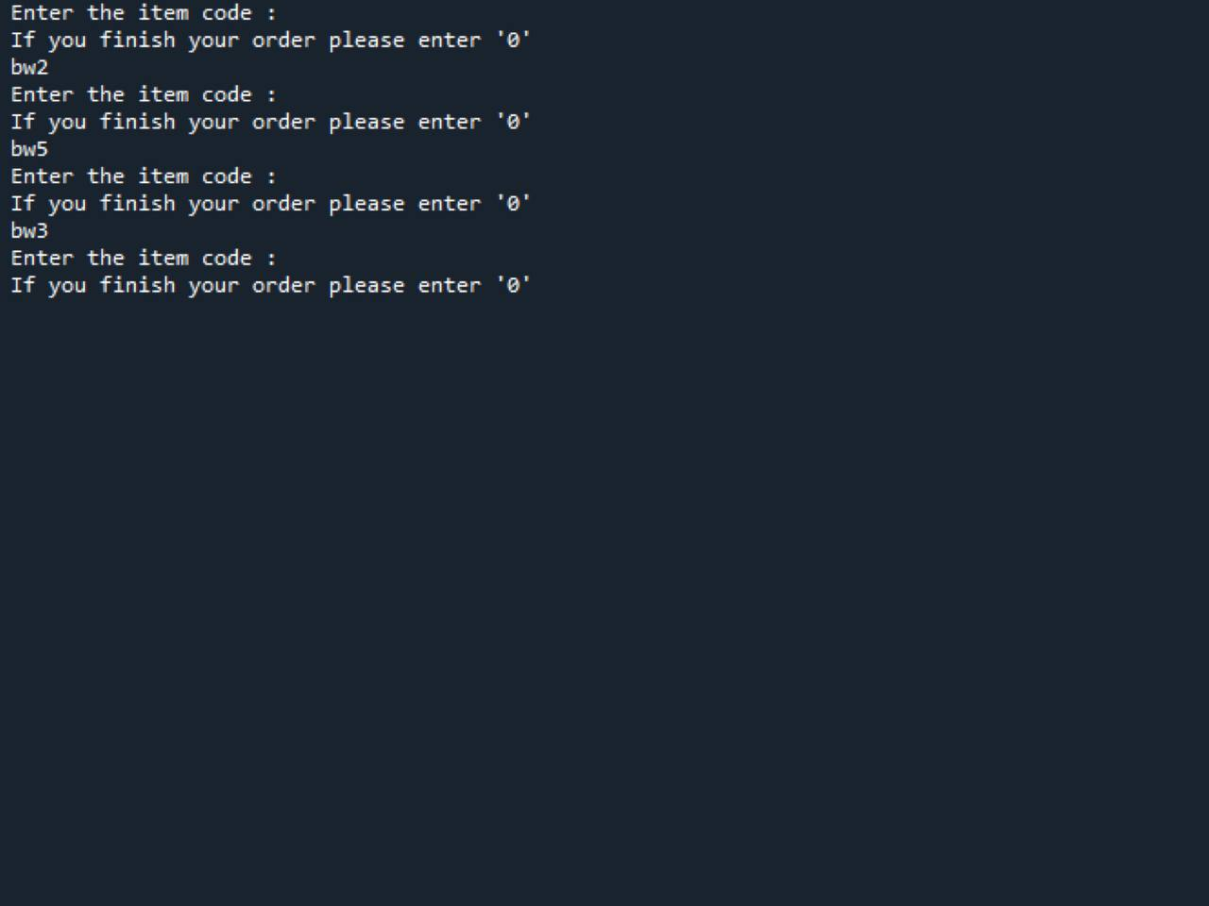

Slide 16
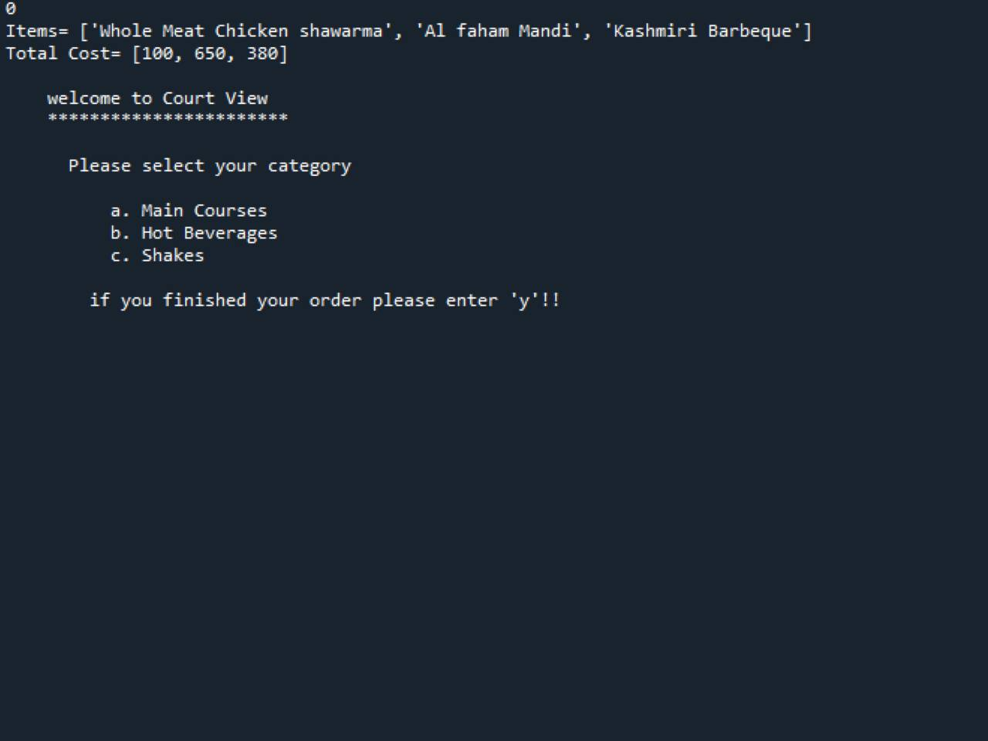
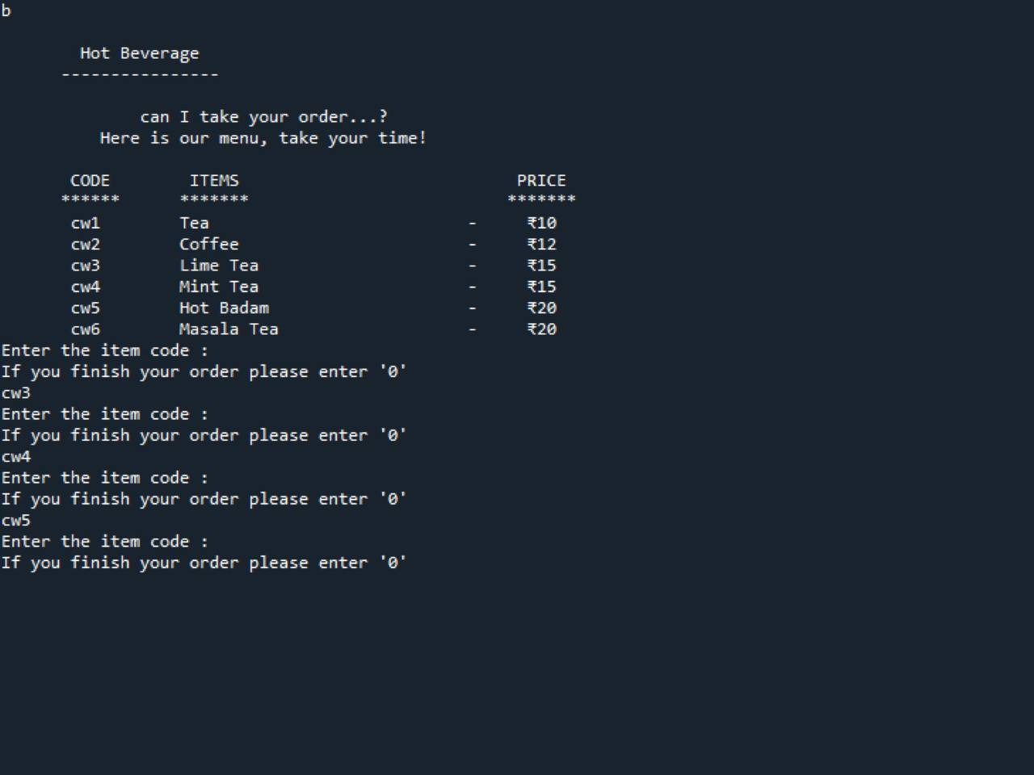

Slide 17
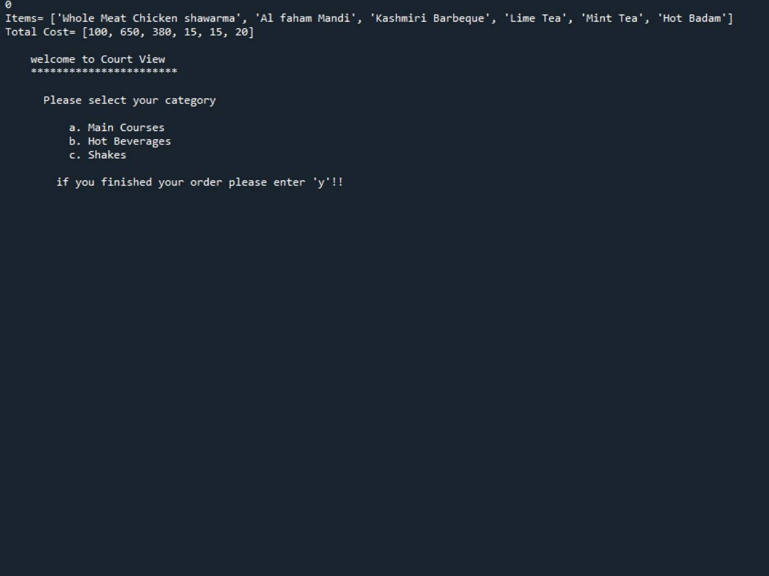

Slide 18
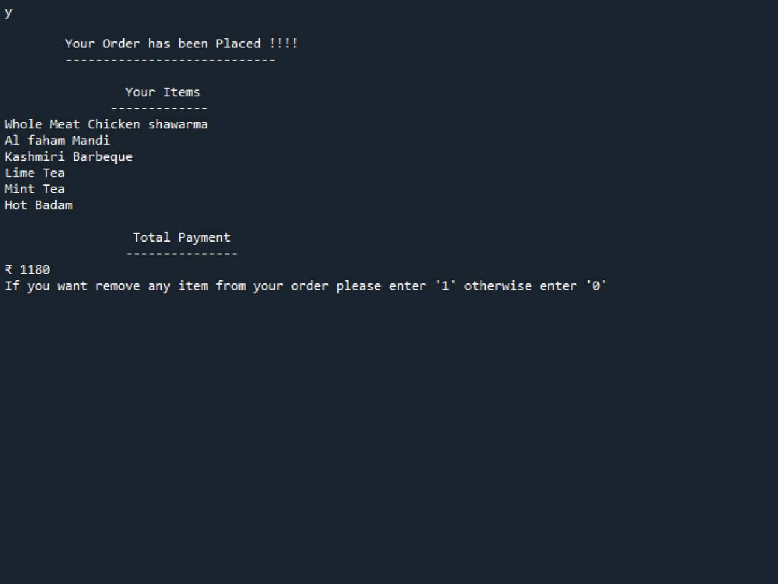
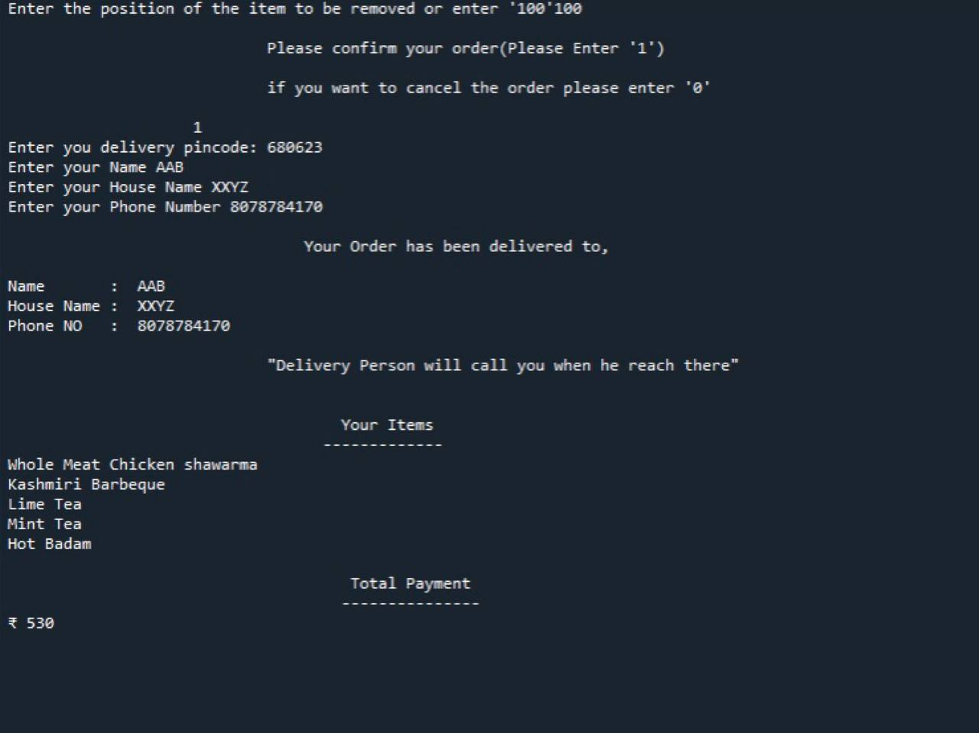

Slide 19
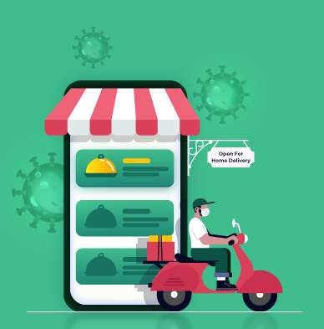
ADVANTAGES
Customers can place an order at virtually any time.
Managing food orders can be easy for restaurants.
Can keep track of all the orders.
Better customers data
Less room for error
Can get rid of close contacts in this present situation(COVID-19)

Slide 20
disadvantages
Service may not be available at rural areas.
Restaurant owners do not have the privilege to add or remove items in
the menu.
This delivery system may lead to lack of social interaction.
Compromise with the food quality.

Slide 21
Thank You

